Slide 1
LAPTOP PERFORMANCE PREDICTION WITH MACHINE LEARNING WITH AN INCREASE IN TECHNOLOGY

Slide 2
LAPTOP PERFORMANCE PREDICTION WITH MACHINE LEARNING WITH AN INCREASE IN TECHNOLOGY
Group Members
Thejashwini Devendra - 700726449
Kamsani Vijay Kumar – 700737910
Maheshwar Reddy Upputuri – 700741748
Amey Ashok Sawant 700740611

Slide 3
LAPTOP PERFORMANCE PREDICTION WITH MACHINE LEARNING WITH AN INCREASE IN TECHNOLOGY
Contribution in Project :
Thejashwini : Collected data on various laptop features such as CPU, GPU, RAM, storage, screen size, and battery life. She also collected some data on the performance metrics of the laptops such as boot time, application launch time, and benchmark scores.
Maheshwar : Focus on preprocessing the collected data by cleaning, formatting, and transforming it into a usable format for machine learning algorithms.
Vijay : Worked on developing machine learning models to predict laptop performance based on the collected and preprocessed data. Also experimented with different models such as Regression models, ecision trees, Naïve Bayes.
Amey : Worked on optimizing the models to improve their accuracy by tweaking the hyperparameters and using more advanced techniques such as ensemble learning.

Slide 4
LAPTOP PERFORMANCE PREDICTION WITH MACHINE LEARNING WITH AN INCREASE IN TECHNOLOGY
MOTIVATION :
The motivation behind "Laptop performance prediction with machine learning with an increase in technology" is to help consumers, businesses, and manufacturers make more informed decisions about laptops by using machine learning to analyze large amounts of data on laptop performance and predict future performance based on advancements in technology.
The goal is to provide better information to enable more effective purchasing, marketing, and product design decisions.
Accurate Laptop performance prediction involves expert knowledge, because performance usually depends on many distinctive features and factors.
Typically, most significant ones are brand and model, RAM, ROM, GPU, CPU, etc. In this work , different methods and techniques in order to achieve higher precision of the used Laptop performance prediction is analyzed.

Slide 5
LAPTOP PERFORMANCE PREDICTION WITH MACHINE LEARNING WITH AN INCREASE IN TECHNOLOGY
OBJECTIVES :
The objective of the statement "Laptop performance prediction with machine learning with an increase in technology" is to use machine learning techniques to predict the performance of a laptop, taking into account advancements in technology over time.
The goal is likely to develop a model that can accurately predict the performance of a laptop based on various features such as CPU, GPU, RAM, storage, and other hardware components.
The model can be trained on historical data and can be used to predict future performance, as newer and more advanced technologies become available.
This information can be used by manufacturers, retailers, and consumers to make informed decisions about purchasing, selling, or upgrading laptops based on their expected performance.

Slide 6
LAPTOP PERFORMANCE PREDICTION WITH MACHINE LEARNING WITH AN INCREASE IN TECHNOLOGY
RELATED WORK :
Accurate laptop performance prediction involves expert knowledge, because of distinctive features and factors.
One approach to laptop performance prediction is to use machine learning.
Machine learning can be used to analyze historical data and identify patterns that can be used to predict future performance.
There are a variety of machine learning algorithms that can be used for laptop performance prediction, including linear regression, decision trees, and neural networks.
The choice of algorithm will depend on the specific data set and the desired accuracy of the prediction.
Once a machine learning model has been trained, it can be used to predict the performance of new laptops.
This information can be used to help manufacturers make decisions about pricing, marketing, and product development.

Slide 7
LAPTOP PERFORMANCE PREDICTION WITH MACHINE LEARNING WITH AN INCREASE IN TECHNOLOGY
PROBLEM STATEMENT :
A significant amount of time, effort, and money is spent by laptop makers building new systems and updated configurations. Depending on how well these systems work, they will be able to save expenses, set affordable rates, and increase their market share.
Due to unique features and circumstances, accurate laptop performance prediction requires expertise. Machine learning is one method for predicting laptop performance. To study historical data and find patterns that can be utilized to forecast future performance, apply machine learning.
Different machine learning algorithms, like as linear regression, decision trees can be applied to forecast laptop performance.

Slide 8
LAPTOP PERFORMANCE PREDICTION WITH MACHINE LEARNING WITH AN INCREASE IN TECHNOLOGY
PROPOSED SOLUTION :
The machine learning algorithms will be applied to find the Laptop based on the different type of attributes. The Laptop brand, cost, specifications, quality of lifetime, warranty features are all covered, and the large dataset of Laptop information is given as input to the project work.
The machine learning algorithm will be applied, and it divides our dataset with 70% with training and 30% to test data. The final prediction will be applied based on the output of the algorithm.
We used Logistic Regression algorithm for predicting the laptop performance based on various attributes. After comparing the logistic regression model with other machine learning models, we got the highest accuracy for logistic regression.

Slide 9
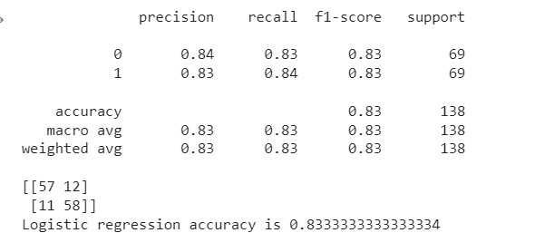
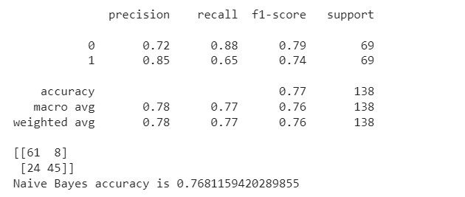
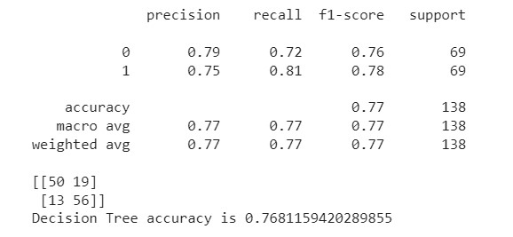
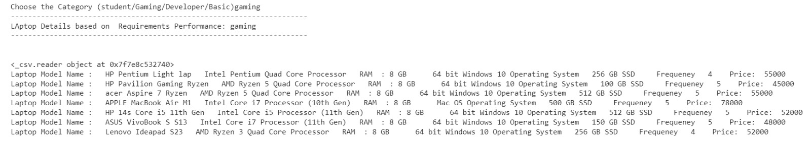
LAPTOP PERFORMANCE PREDICTION WITH MACHINE LEARNING WITH AN INCREASE IN TECHNOLOGY
Results :

Slide 10
LAPTOP PERFORMANCE PREDICTION WITH MACHINE LEARNING WITH AN INCREASE IN TECHNOLOGY
References :
Noor, K., Jan, S. (2017). Vehicle Price Prediction System using Machine Learning Techniques. International Journal of Computer Applications, 167(9), 27-31.
Nugroho, A., Hidayanto, A. N., & Prabowo, H. (2020). Decision Support System with Fuzzy Multi-Attribute Decision Making (FMADM) and Simple Additive Weighting (SAW) In Laptop Vendor Selection. Journal of Physics: Conference Series, 1467(1), 012013.
Ho, T. K. (1995, August). Random decision forests. In Document analysis and recognition, 1995., proceedings of the third international conference on (Vol. 1, pp. 278-282).
Pudaruth, S. (2014). Predicting the price of used cars using machine learning techniques. Int. J. Inf.Comput. Technol, 4(7), 753-764.
Utku A, Hacer (Uke) Karacan, Yildiz O, Akcayol MA. Implementation of a New Recommendation System Based on Decision Tree Using Implicit Relevance Feedback. JSW. 2015 Dec.

